Slide 1
Lecture 15: Dependent Sample t-test
Jibo He, Ph.D.
Associate Professor
Wichita State University
jibo.he@Wichita.edu

Slide 2
Research Considerations with Dependent Samples
Dependent samples design: a study in which measurements in one sample are statistically related to measurements in the other sample(s)
There are three ways in which dependent samples may be generated:
Repeated measures design: a study in which observations are measured on the same subject under two (or more) conditions, such as the case when participants are measured at two or more time points.

Slide 3
Research Considerations with Dependent Samples
Matched subjects design: a study in which subjects from two (or more) samples are paired (matched) by the experimenter on an outside variable (such as the demographic variables).
Assumptions for matched design: the correlation of dependent variable between samples is not zero, normally, the correlation r>.3
Matched-pairs design: a study in which subjects from two groups are naturally paired (e.g. twins)

Slide 4
Examples of Research Hypotheses with Dependent Groups
An English composition professor is interested in whether students who listen to classical music while writing produce essays that are of a higher quality than students who write in silence. The professor has each of his students write two essays – one while listening to classical music and one in silence. The professor then compares grades on the two sets of essays.

Slide 5
Examples of Research Hypotheses with Dependent Groups
A university researcher is interested in whether students in a special college retention program have higher college GPAs than students who do not participate in the program. To eliminate prior factors that may influence college GPA the researcher matches subjects based on their placement test scores and then assigns one member of each pair to participate in the program and the other member to the control group.

Slide 6
Advantages of Dependent Groups Designs
There is ensured comparability across treatment groups. Reducing the sampling variability across groups has the potential to increase the power of the test.
The repeated measures design reduces the number of subjects you need. This may be helpful in situations where it is expensive or difficult to obtain many subjects.
Fewer assumptions are necessary to carry out a t test than with an independent samples design.

Slide 7
Limitations of Dependent Groups Designs
Order effect: when making repeated measurements on the same subjects, exposure to the treatment condition assigned first changes performance on the treatment condition assigned second.
For the English composition example order effects might occur if:
the effect of listening to classical music continued while students were writing a second essay in silence
the students were tired after writing the first essay and subsequently performed more poorly on the second essay

Slide 8
Statistical Hypotheses (same as the independent sample t-test)
When we conduct a hypothesis test on independent groups we look at the difference between two population means.
Statistical hypotheses with a non-directional alternative:
Statistical hypotheses with directional alternatives:
(a)
(b)

Slide 9
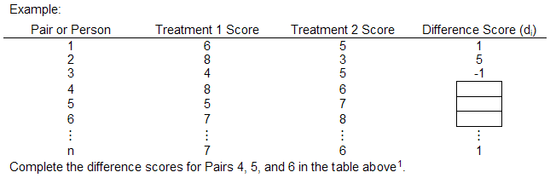
Compute difference score first
Difference scores (d_{i}): the differences between corresponding pairs of scores across the two treatments, that is d_{i} = X_{i1} – X_{i2}
Xi1 is the score on the dependent variable for treatment 1, and
Xi2 is the score on the dependent variable for

Slide 10
Statistical Hypotheses
The mean of the population of difference scores
We can use this relationship to reformulate our statistical hypotheses
Statistical hypotheses with a non-directional alternative:
Statistical hypotheses with a directional alternative:

Slide 11
Sampling Distribution
The statistic corresponding to is:
Therefore, we may use the sampling distribution of
to generate appropriate test statistics for the above hypotheses

Slide 12

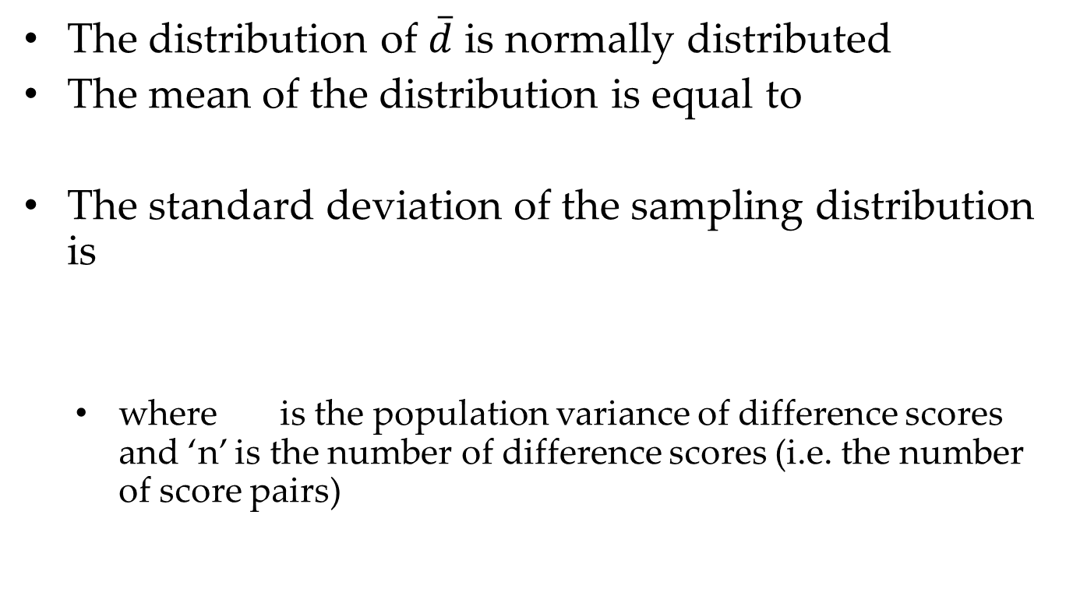
Properties of $\overline{d}$
The distribution of $\overline{d}$ is normally distributed
The mean of the distribution is equal to
The standard deviation of the sampling distribution is
where is the population variance of difference scores and ‘n’ is the number of difference scores (i.e. the number of score pairs)

Slide 13
The t Statistic and Critical Values
Rarely do we know the value of the population variance of the difference scores. We can estimate the value of from our sample data using the following formula:
If we replace the population variance with its sample estimate, the estimate of the standard error of the mean of difference scores is:

Slide 14
The t Statistic and Critical Values
We then have the following t-statistics:
with df = n – 1
Critical values are obtained using a t distribution table

Slide 15
Underlying assumptions for the Two Sample t Test for Dependent Groups
The difference scores on the dependent variable are measured independently.
2. The population of difference scores is normally distributed

Slide 16
Example
Dr. Fredericks believes that environment has an effect on intelligence, specifically, that being raised in an enriched environment results in higher IQ test scores than being raised in an impoverished environment. He locates 12 pairs of identical twins that have been reared apart, one twin in each pair in an enriched environment and the other in an impoverished environment. He administers a standardized IQ test and obtains the results shown below

Slide 17
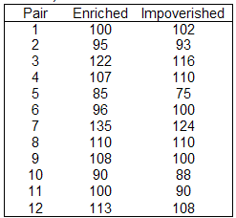
Conduct an appropriate hypothesis test at the .05 level of significance

Slide 18
Step1. Based on the Research Hypotheses, specify the appropriate statistical hypotheses (H_{A} and H₀).
Step2. Specify the test to perform, the level of significance, sample size (degrees of freedom, if needed) and the directionality of the test
Two Sample t Test for Dependent Groups
α = .05
n = 12
df = n – 1 = 12 – 1 = 11
Since H_{A}: μ_{d} > 0, this will be a one tailed test with region of rejection in the upper tail of the distribution; the area under the curve in the region of rejection will be .05.

Slide 19
Step3. Sketch the sampling distribution of the test statistic with the region of rejection shaded and the critical value(s) clearly indicated
Step4. Compute the test statistic using the sample data.
Before you can compute the test statistics, you need to compute the difference scores. Be sure that the method used to calculate the difference scores matches the way the statistical hypotheses were formulated in Step 1!

Slide 20
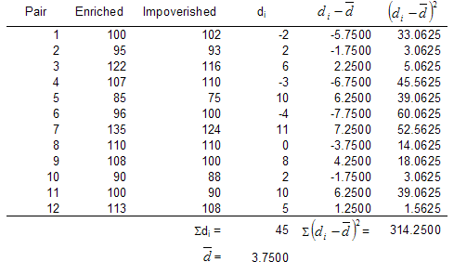

Slide 21
Step5. Locate the observed test statistic on the sampling distribution and state the decision regarding H₀
Reject the null hypothesis
Step6. Interpret the results to answer the researcher’s question.
There is statistically significant evidence that being raised in an enriched environment results in higher IQ test scores than being raised in an impoverished environment

Slide 22
Examples Using the Two Sample t Test for Dependent Groups

Slide 23
Examples Using the Two Sample t Test for Dependent Groups

Slide 24
A little knowledge check
For each of the following scenarios, indicate whether the researcher should perform an independent-groups or dependent-groups t-test, and whether the test should be one-tailed or two-tailed.
A statistics instructor thinks that students might have a lower opinion of him after they have taken an exam. At the beginning of the semester, the instructor gives the students an anonymous survey asking the students’ opinions of the instructor. (Because the survey is anonymous, the instructor cannot identify which students gave which responses.) Later in the semester, after the first exam, the instructor gives the students the same survey. The instructor compares the mean ratings on the first survey to the ratings on the second survey.
Independent Groups / Correlated Groups one-tailed / two-tailed

Slide 25
A little knowledge check
For each of the following scenarios, indicate whether the researcher should perform an independent-groups or dependent-groups t-test, and whether the test should be one-tailed or two-tailed.
A statistics instructor thinks that students might have a lower opinion of him after they have taken an exam. At the beginning of the semester, the instructor gives the students an anonymous survey asking the students’ opinions of the instructor. (Because the survey is anonymous, the instructor cannot identify which students gave which responses.) Later in the semester, after the first exam, the instructor gives the students the same survey. The instructor compares the mean ratings on the first survey to the ratings on the second survey.
Independent Groups / Correlated Groups one-tailed / two-tailed

Slide 26
A researcher suspects that Psychology majors are more likable than Engineering majors. The researcher randomly selects a sample of Psychology majors and a sample Engineering majors. The researcher interviews all the subjects and rates their personalities from 1 (very unpleasant) to 7 (very pleasant). The researcher compares the mean ratings for the two groups.
Independent Groups / Correlated Group one-tailed / two-tailed

Slide 27
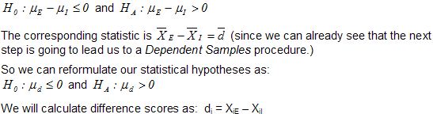
Examples Using the Two Sample t Test for Dependent Groups
Step1. Based on the Research Hypotheses, specify the appropriate statistical hypotheses (H_{A} and H₀).

Slide 28
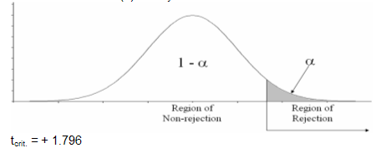
Examples Using the Two Sample t Test for Dependent Groups
Step3. Sketch the sampling distribution of the test statistic with the region of rejection shaded and the critical value(s) clearly indicated

Slide 29
Examples Using the Two Sample t Test for Dependent Groups
Step4. Compute the test statistic using the sample data.
Before you can compute the test statistics, you need to compute the difference scores. Be sure that the method used to calculate the difference scores matches the way the statistical hypotheses were formulated in Step 1!

Slide 30
Example: Dependent-sample T-Test
All of the subjects had received an Implantable Cardioverter Defibrillator (ICD) between October of 2003 and August of 2006 and had scores on the IES-R that were equal to or greater than the clinical cutoff for a diagnosis of Posttraumatic Stress Disorder (PTSD) – it seems that getting sudden cardiac shocks is pretty stressful. The data that we shall use in this lesson are those for the subjects that had been randomly assigned to receive a psychological intervention designed to reduce the symptoms of PTSD.
For each subject we have two scores – a pretest score on the IES-R and a posttest score on the IES-R. The posttest score was obtained six months after completion of the intervention. The data are in a plain text file, blank spaces as delimiter, variable names on the first line.

Slide 31
Dependent-sample T-Test in R
#install.packages("psych")
icd <- read.table("/Users/hejibo/Documents/Courses to teach /PSY 301 Psychological Statistics course/Psychological-Statistics/Lecture 15_dependent t-test/Dependent sample -t-test/ICD_Pre_Post.txt", header=TRUE, sep=" ")
library(psych)
describe(icd)
t.test(icd$Pre,icd$Post,paired=TRUE)

Slide 32
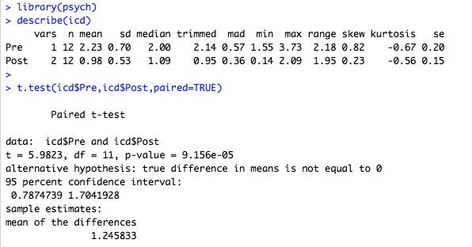
Dependent-sample T-Test in R

Slide 33
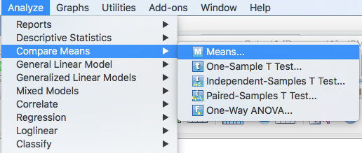
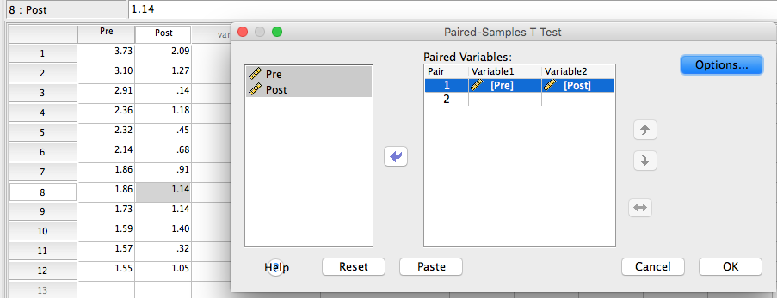
Dependent-sample T-Test in SPSS

Slide 34
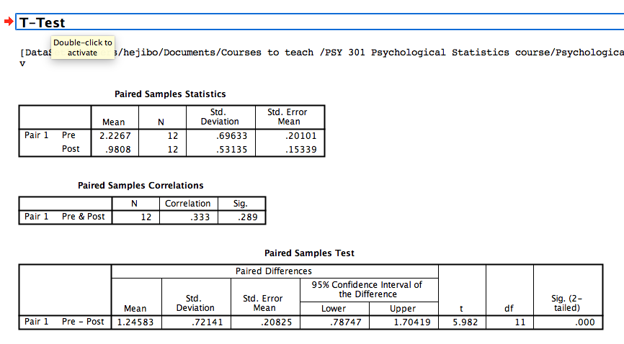
Dependent-sample T-Test in SPSS

